Slide 1
AngularJS part 4
By Arul

Slide 2
Topics
Custom Directives
Filters
Custom Filters

Slide 3
Custom Directives
What are Directives?
Markers on a DOM element that tell AngularJS’s HTML compiler ($compile) to attach a specified behaviour to that DOM element…
Teaching new Tricks to the HTML

Slide 4
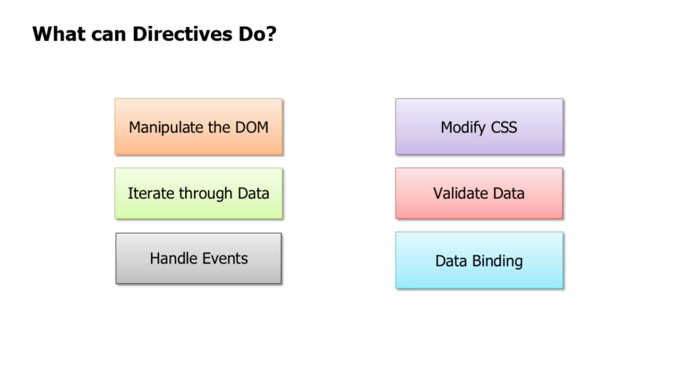

Slide 5
Directive Types :
The restrict option is typically set to:
'A' - only matches attribute name
'E' - only matches element name
'C' - only matches class name
'M' - only matches comment
You can implement the following types of directives:
Element directives (E) - <my-dir></my-dir>
Attribute directives (A) - <span my-dir="exp"></span>
CSS class directives (C) - <span class="my-dir: exp;"></span>
Comment directives (M) - <!-- directive: my-dir exp -->

Slide 6
Basic Directive
myapp = angular.module("myapp", []); myapp.directive(‘postList’, function() { var directive = {}; directive.restrict = 'E'; /* restrict this directive to elements */ directive.template = "My first directive: {{title}}"; return directive; });

Slide 7
template and templateUrl Properties
In case that HTML template grows big, it is gets hard to write and maintain the HTML inside a JavaScript string. You can then put the HTML into its own file and have AngularJS load it from that file.
myapp = angular.module("myapp", []); myapp.directive('postList', function() { var directive = {}; directive.restrict = 'E'; /* restrict this directive to elements */
//directive.template = "My first directive: {{title}}"; directive.templateUrl = "/blog/post/postListView.html"; return directive; });

Slide 8
Isolating the $scope from the directive
Our postList directive above is great but not a cool solution. What we want to be able to do is separate the scope inside a directive from the scope outside, and then map the outer scope to a directive's inner scope. We can do this by creating what we call an isolate scope
To create an isolate scope, simply pass an object back in the scope option:
scope: {}
OneWay binding: @ (or @attr)
Bi-directional binding: = (or =attr)
Parent execution binding :& (or &attr)

Slide 9
myapp.directive('userinfo', function() { var directive = {}; directive.restrict = 'E'; directive.template = "Home - {{title}}"; directive.scope = { title : "=title" } return directive; })

Slide 10
The compile() and link() functions
The compile() and link() functions define how the directive is to modify the HTML that matched the directive.
The compile() function is called once for each occurrence of the directive in the HTML page. The compile() function can then do any one-time configuration needed of the element containing the directive.
The compile() function finishes by returning the link() function. The link() function is called every time the element is to be bound to data in the $scope object.

Slide 11
<script> myapp = angular.module("myapp", []); myapp.directive(blogList, function() { var directive = {}; directive.restrict = 'E'; /* restrict this directive to elements */ directive.compile = function(element, attributes) { // do one-time configuration of element. var linkFunction = function($scope, element, atttributes) { // bind element to data in $scope } return linkFunction; } return directive; }); </script>

Slide 12
Wraps Elements Via Transclusion
<postList>This is a transcluded directive {{title}}</postList> <script> myapp = angular.module("myapp", []); myapp.directive('mytransclude', function() { var directive = {}; directive.restrict = 'E'; /* restrict this directive to elements */ directive.transclude = true; directive.template = "<div class='myTransclude' ng-transclude></div>"; return directive; }); myapp.controller("MyController", function($scope, $http) { $scope.firstName = "Jakob"; }); </script>

Slide 13
Reference
https://docs.angularjs.org/guide/directive

Slide 14
Filter
Filters format the value of an expression for display to the user. They can be used in view templates, controllers or services. AngularJS comes with a collection of built-in filters, but it is easy to define your own as well.

Slide 15
Using Filter in the View Templates
{{ expression | filter }}
Filters can be applied to the result of another filter. This is called "chaining" and uses the following syntax:
{{ expression | filter1 | filter2 | ... }}
Filters may have arguments. The syntax for this is
{{ expression | filter:argument1:argument2:... }}
<p>{{post.body | limitTo:70}}...</p>
<li ng-repeat="post in posts | filter:searchText">

Slide 16
Using filter in Javascript(controller,service…)
You can also use filters in controllers, services, and directives. For this, inject a dependency with the name <filterName>Filter into your controller/service/directive
uppercaseFilter($scope.selectedPost.title);
$filter('uppercase')($scope.title);

Slide 17
Filter Reference
https://docs.angularjs.org/api/ng/filter

Slide 18
Custom Filter
Writing your own filter is very easy: just register a new filter factory function with your module
app.filter('makeUppercase', function () {
return function (item) {
return item.toUpperCase();
};
});

Slide 19
app.filter("arrayToFormattedString", [function () { return new shops.filters.ArrayToFormattedString() }])
shops.filters.ArrayToFormattedString = function () {
var self = this;
self.hasArray = function (inputArray) {
return angular.isArray(inputArray) && inputArray.length > 0
}
self.hasPropertyName = function (propertyName) {
return !angular.isUndefined(propertyName);
}
self.hasSeparator = function (separator) {
return !angular.isUndefined(separator);
}
self.hasValue = function (value) {
return value !== undefined && value != null;
}
return function (array,propertyName,separator) {
var tempString = "";
if (!self.hasArray(array) || !self.hasPropertyName(propertyName) || !self.hasSeparator(separator)) {
return tempString;
}
array.forEach(function (each) {
if(self.hasValue(each[propertyName])){
tempString += each[propertyName] + separator;
}
});
return tempString.length > 0 ? tempString.slice(0, tempString.lastIndexOf(separator)) : tempString;
}
}

Slide 20
Thank you!

